Slide 1
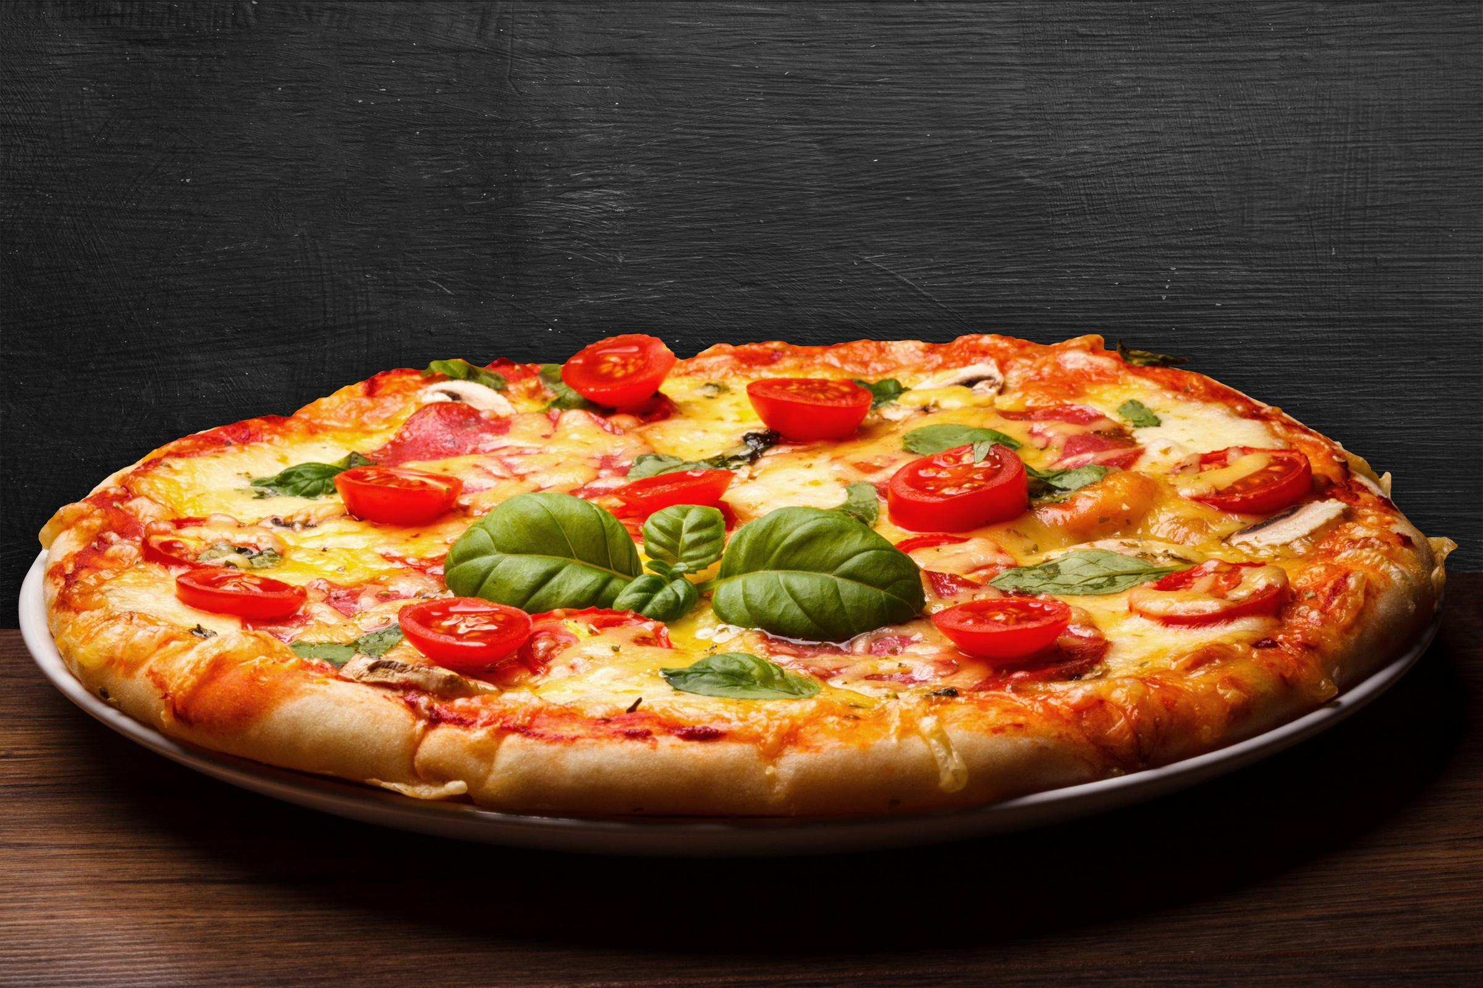

larana pizza
larana pizza

Slide 2


Summary
This presentation delves into pizza sales data using MySQL to perform detailed data analysis. By utilizing SQL queries to extract, manipulate, and aggregate data, the analysis provides insights into sales trends, customer preferences, and business performance. Key areas of focus include identifying popular pizza types, peak sales times, and customer demographics. The goal is to translate this data into actionable insights for improving sales strategies and operational efficiency.

Slide 3
Objective
Leverage MySQL to query and analyze pizza sales data for key trends and insights.
Identify major drivers of sales, such as popular products and high-demand time periods.
Use SQL analysis to make data-driven recommendations for inventory optimization, marketing, and customer engagement strategies.
Demonstrate how SQL can enhance data-driven decision-making for improving business performance.

Slide 4
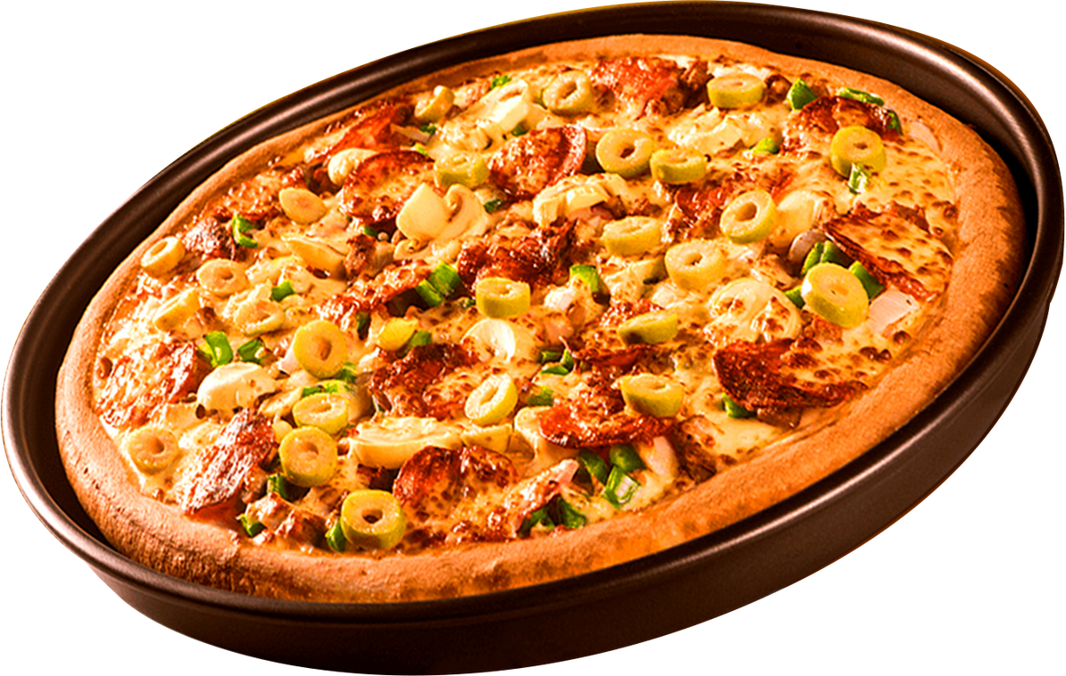

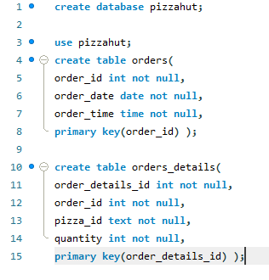
Created the Databases

Slide 5

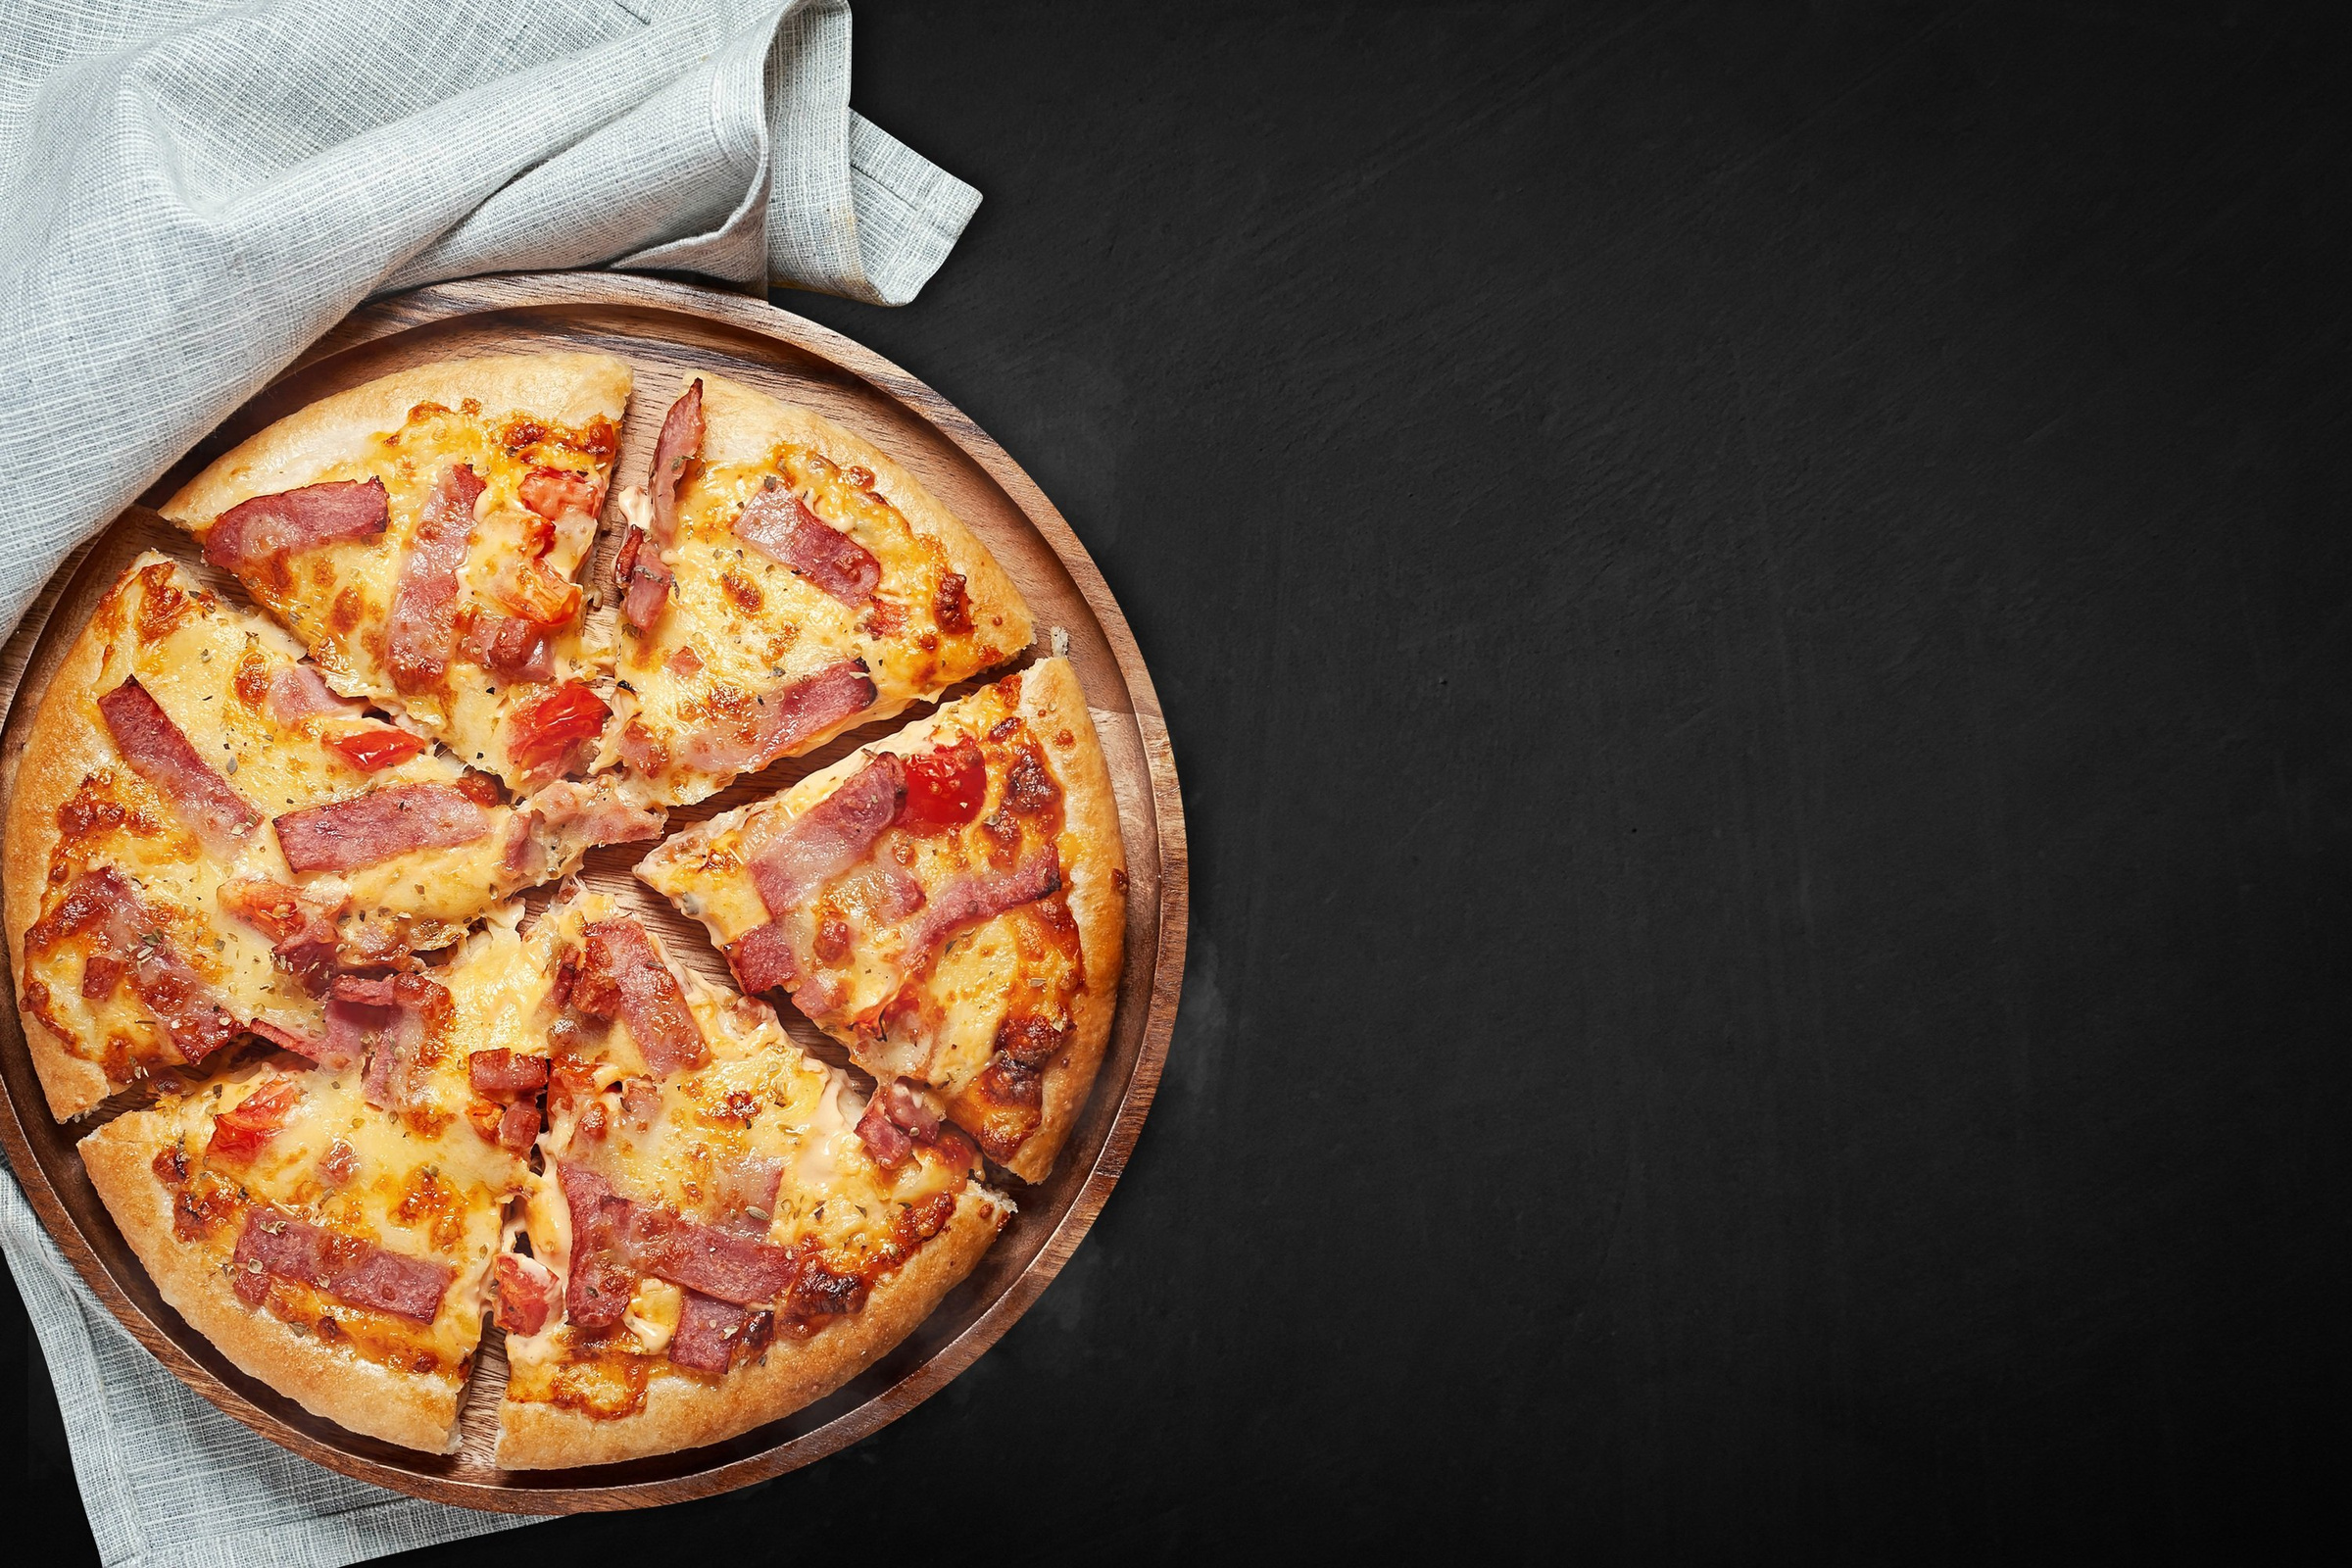
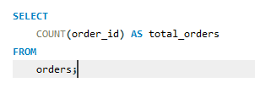
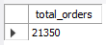
Retrive the total number of order placed

Slide 6
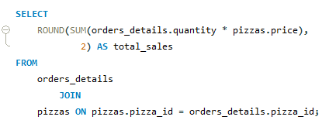
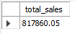
calculate the total revenue generated from pizza sales
Notes:
calculate the total revenue generated from pizza sales

Slide 7

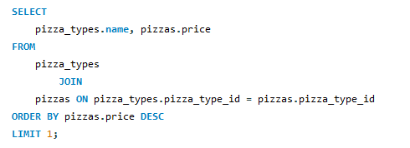
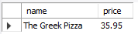
Identified the highest-priced pizza

Slide 8
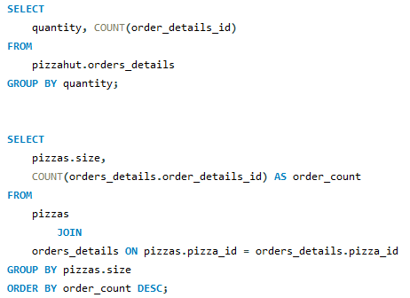
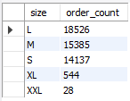
Identifed the most common pizza size orders

Slide 9
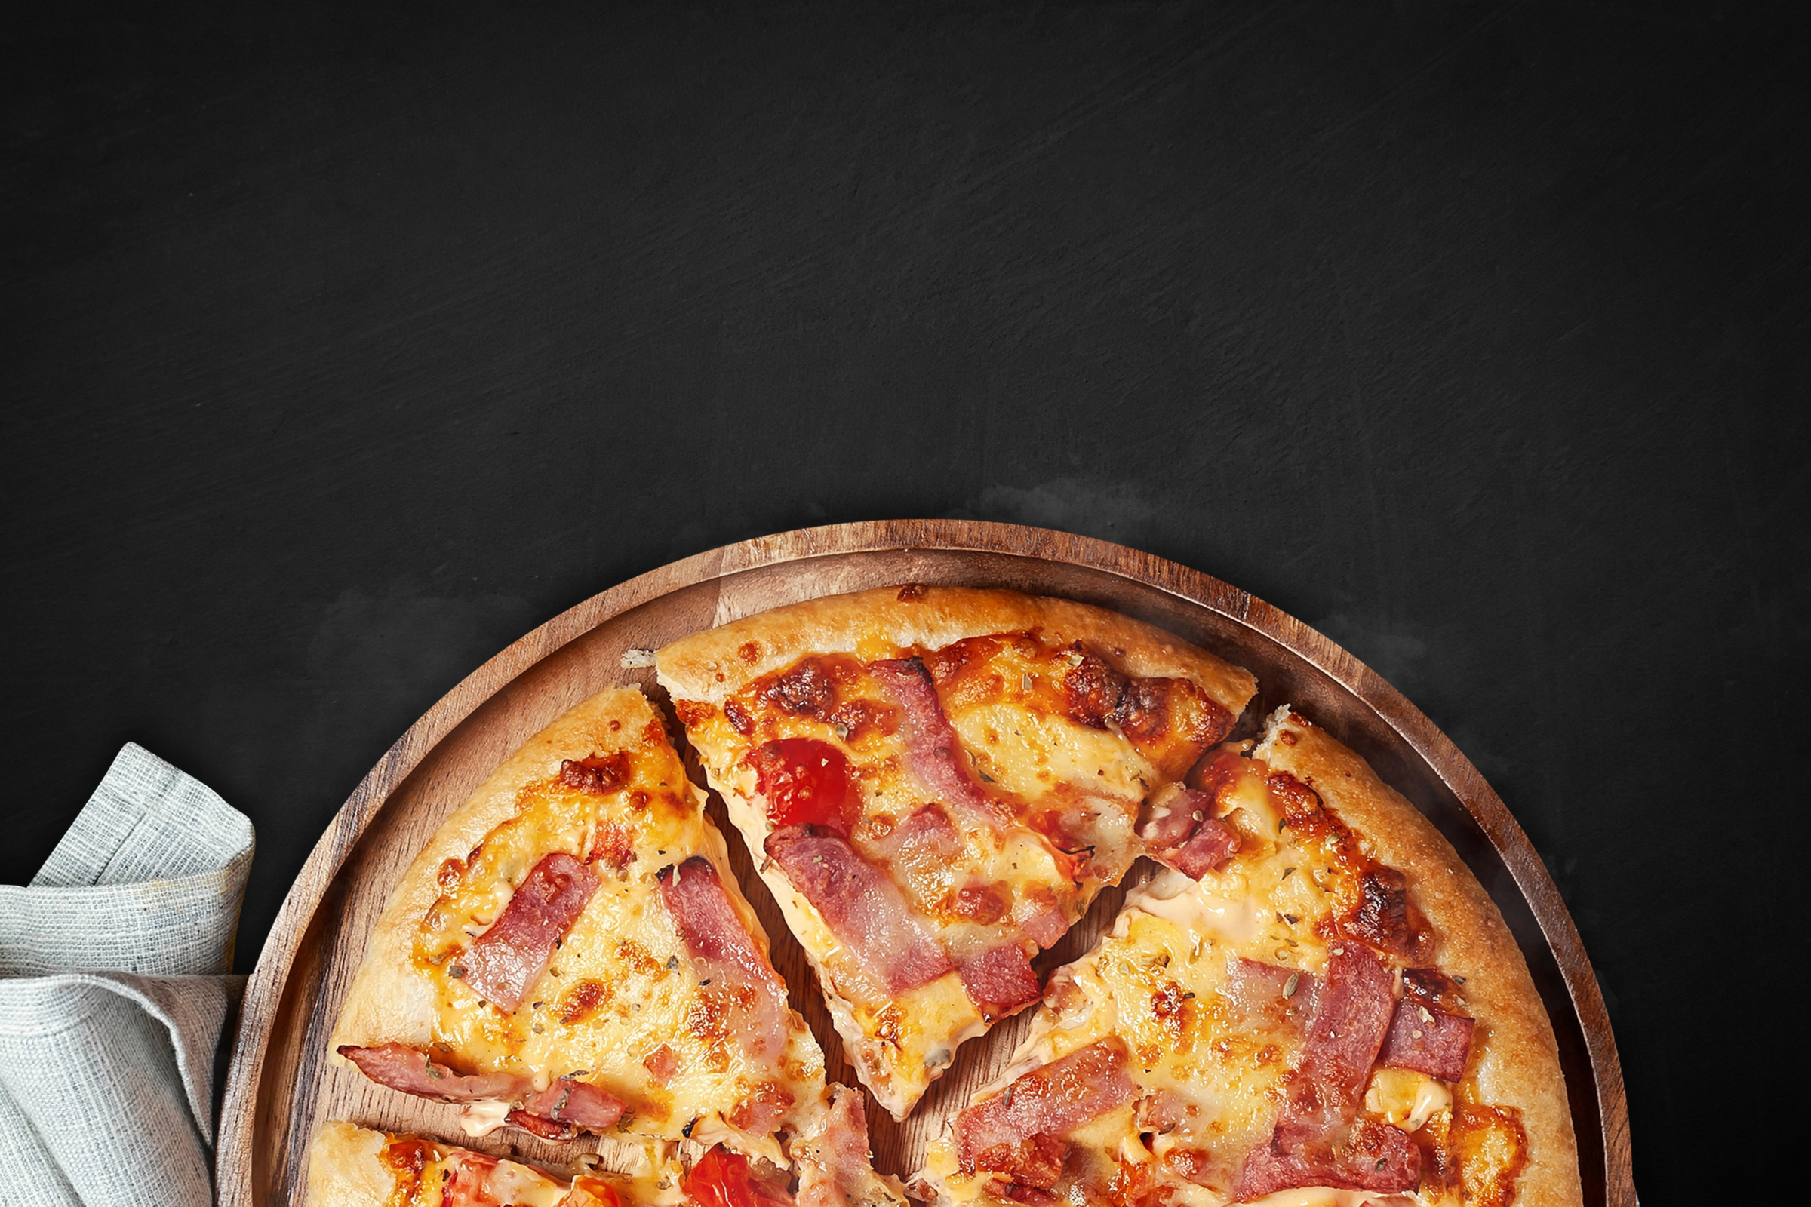
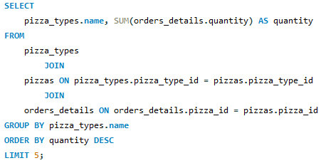
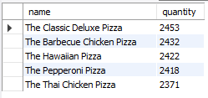
list of top 5 most ordered pizza types along with their quantities

Slide 10

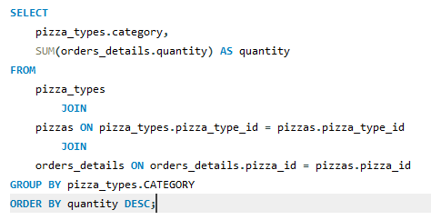
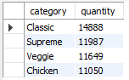
joined the necessary tables to find the total quantity of each pizza category ordered

Slide 11

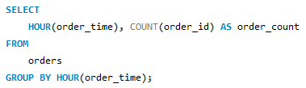
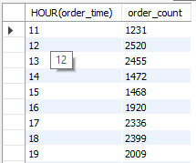
Determined the distribution of orders by hour of the day

Slide 12
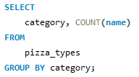
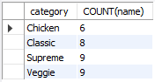
joined relevant tables to find the category-wise distribution of pizzas

Slide 13
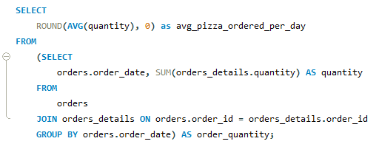
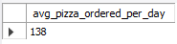
Group the orders by date and calculate the average number of pizzas ordered per day

Slide 14
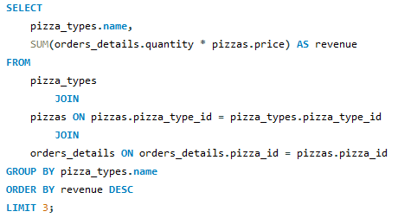
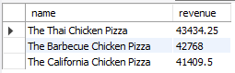
The top 3 most ordered pizza types based on revenue

Slide 15
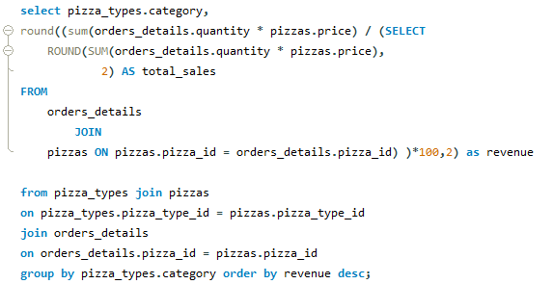
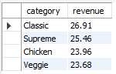
calculated the percentage contribution of each pizza type to total revenue

Slide 16
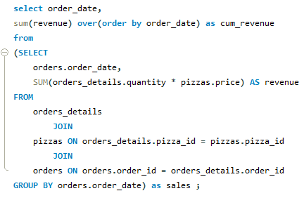
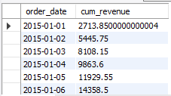
analysed the cumulative revenue generated over time

Slide 17
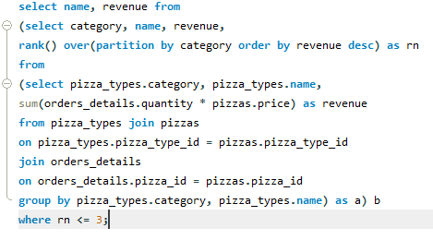
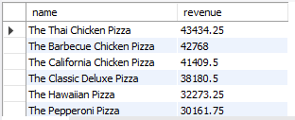
top 3 most ordered pizza types based on revenue for each pizza category

Slide 18
thank you!

